Slide 1

TEAM NAME : PHOENIX
IDEA TITLE : MAKING CAREER CHOICES AND COUNSELLING ACCESSIBLE TO EVERYON AT ENGINEERING LEVEL ALONG WITH APTITUDE TESTS AND DETAILED CAREER PATHS TEAM LEADER NAME : DHANUSH KUMAR V DOMAIN NAME : OPEN INNOVATION
PROBLEM STATEMENT: STUDENTS UNDERSTAND THEIR CAREER OPTIONS, UNDERSTAND THE STRENGTH AND WEAKNESS , KNOWS WHAT CAREER THEY WOULD BE SUITED FOR, BOOST SELF CONFIDENCE AND SELF ASSURANCE

Slide 2
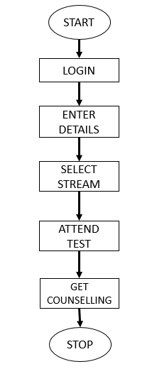
Idea /Approach Details
Virtual experiences for career exploration.
Develop standardized aptitude tests that are suitable for students at the engineering level. These tests could be administered electronically to provide quick results.
Share success stories of individuals who followed similar career paths, showcasing the achievements of people who made informed career decisions.
Create interactive modules that allow students to explore various career paths through gamified or immersive experiences.
Develop essential skills.
Equal opportunities for all students.
Ensure that the data collected from students for career guidance purposes is handled with strict privacy and security measures in place.
Create interactive modules that allow students to explore various career paths through gamified or immersive experiences.
Ensure inclusivity for students with disabilities.
Integrate career guidance into the academic curriculum, helping students understand the link between their studies and future careers.
Showcase achievements of similar career paths.
Technology Stack :
Weblinks – Google Cloud .
Backend- Php , MySQL
Frontend–HTML,Bootstrp,CSS.

Slide 3
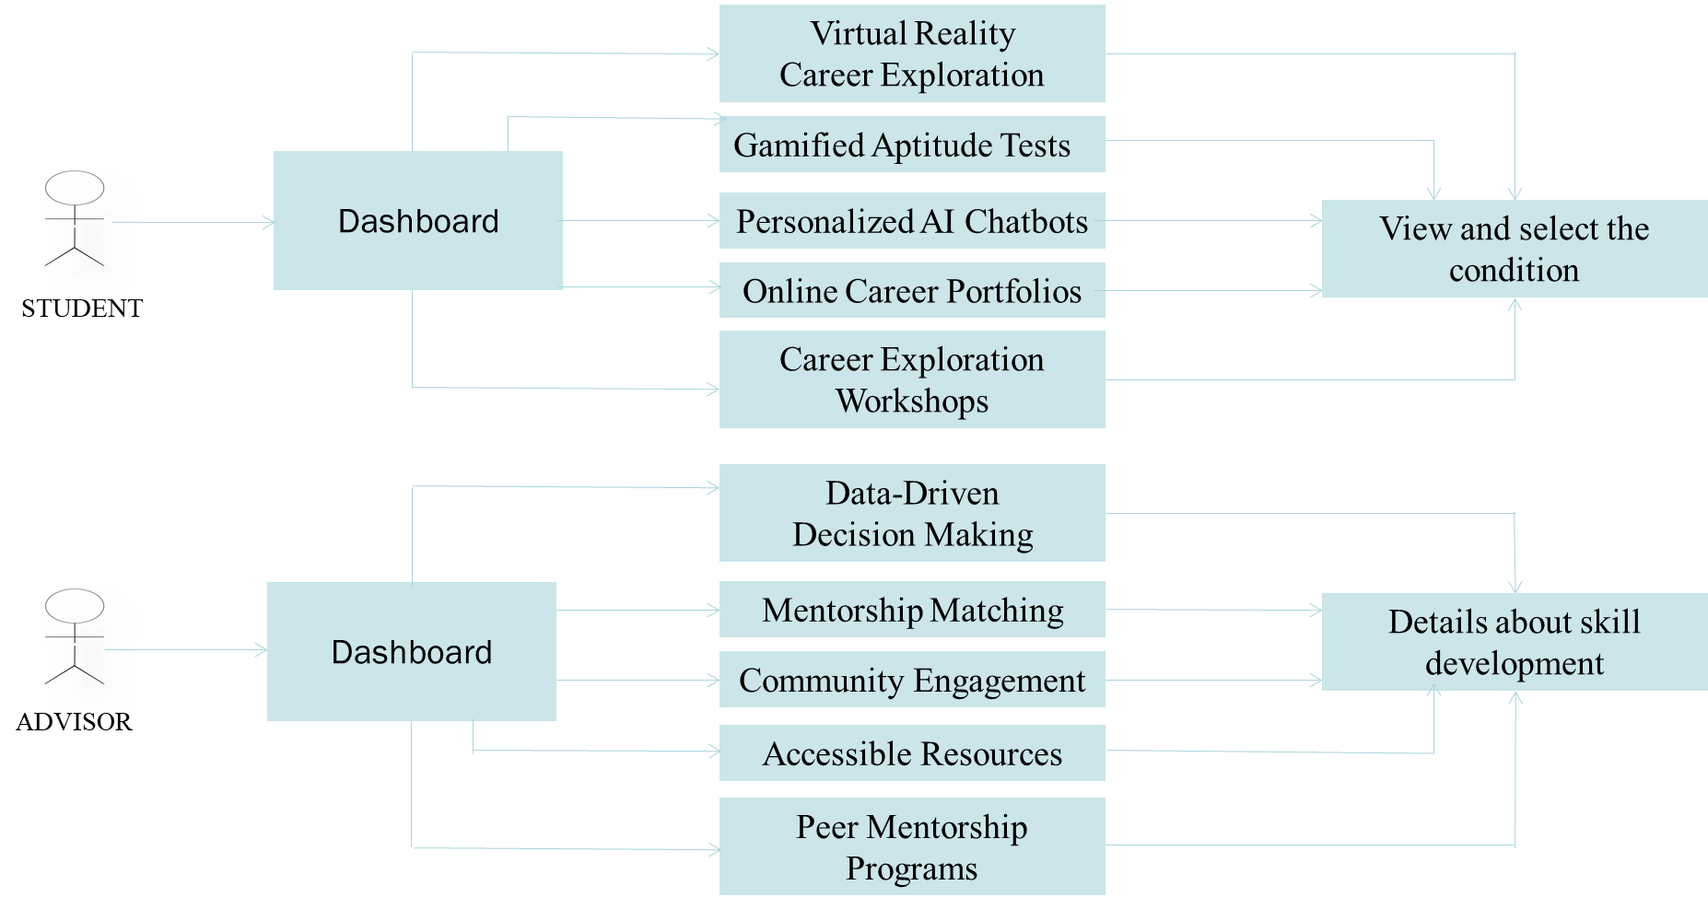
Idea / Approach Details
USE CASE :
DEPENDENCIES :
Knowledge Gained
Virtual Reality Career Exploration
Aptitude Tests
Career Exploration Workshops
Career Portfolios
Accessible Resources
Virtual Reality
Career Exploration
Quiz
DASHBOARD
Various Course Details
View and Select the Condition
Various Course Portfolio

Slide 4
Team Member Details
Sr. No. | Name of Team Member | Branch (Btech/Mtech/PhD etc): | Stream (ECE, CSE etc): | Year | Position in team (Team Leader, Front end Developer, Back end Developer, Full Stack, Data base management etc.)
1 | DHANUSH KUMAR V | MSC | IT | I | TEAM LEADER
2 | ABINAYA K | MSC | IT | I | FRONT END
3 | GOKULAKRISHNAN D | MSC | IT | I | FULL STACK
4 | SIVARAMAKRISHNAN P | MSC | IT | I | DATABASE MANAGEMENT
Team Mentor/s Details
Sl. No. | Name of Mentor | Category (Academic/Industry): | Expertise (AI/ML/Blockchain etc): | Domain Experience (in Years )
1 | DR .W ROSEVARUNA | ACADEMIC | NETWORKING | 12+
2 | DR .R VADIVEL | ACADEMIC | NETWORKING | 15+

